Slide 1
Unit 2 Key historical concepts CONTINUITY AND CHANGE CASE STUDY

Slide 2
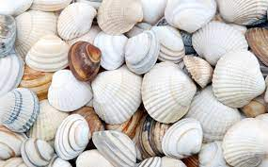
Focus on: Continuity and change Textbook, p. 30
currency – money that is used in a particular country
intrinsic – inherent, natural
salary vs wage
salary – a fixed amount of money paid to an employee, directly into their bank account
wage - a fixed amount of money paid usually weekly to an employee who does work that needs physical skills and strength

Slide 3
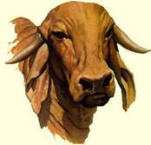
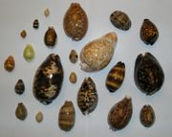
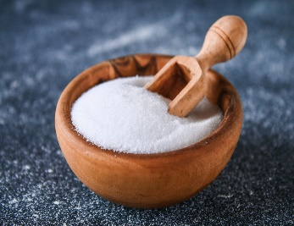
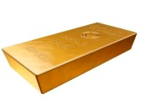
Money: its origins
Different objects had been used as money in the past:
cattle
cowrie shells
salt
gold
Such forms of money are called COMMODITY MONEY
What other goods were used as money in the past?
For example, commodities such as cigarettes and coffee were used as money in Germany in 1945.

Slide 4
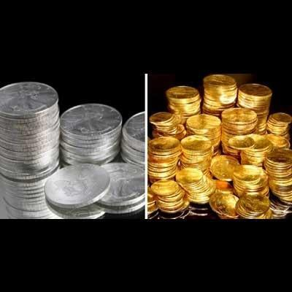
Money: its origins
Throughout its history money has taken the form of coins made of precious metal – gold and silver.
Such commodity money had intrinsic value.
INTRINSIC VALUE – the item would have value even if it were not used as money

Slide 5
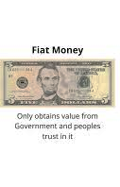
Money: its origins
Another type of money is fiat money.
Fiat money is a government-issued money that is not backed by a commodity such as gold or silver.
Fiat money is money without intrinsic value.
DEKRETNI NOVAC

Slide 6
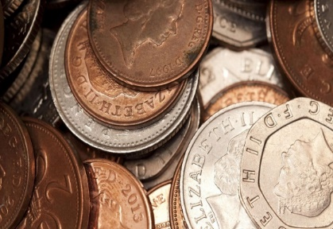
Money: its attributes
1. Acceptability – money must be universally accepted as payments for goods and services.
2. Durability – money should last a long time and resist physical wear.
3. Homogeneity – any two units of money should be uniform or the same in terms of size, weight and value.

Slide 7
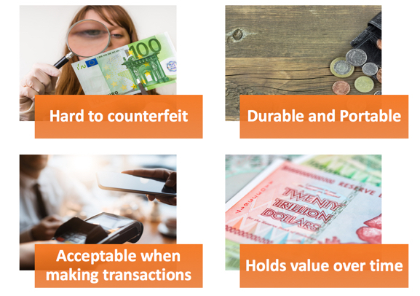
Money: its attributes
4. Divisibility – money needs to be divided into smaller units so that you can buy things of different value and get change.
5. Portability – money needs to be easy to carry around.
6. Stability of value – money should hold its value over time.
7. Difficult to counterfeit – money must not be easily copied or faked; it must be resistant to fraud.

Slide 8
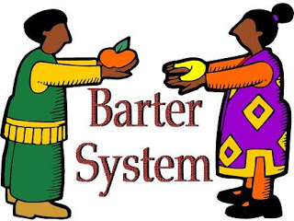
Barter
if there were not money, exchange would have to take place by barter
TRAMPA
In trade, barter is a system of exchange in which participants in a transaction directly exchange goods or services for other goods or services without using a medium of exchange such as money.

Slide 9
Barter
for barter to be possible there must be a...
double coincidence of wants
an economic phenomenon where two parties each hold an item the other wants, so they exchange these items directly without any monetary medium
both of the parties have to agree to sell and buy each commodity

Slide 10
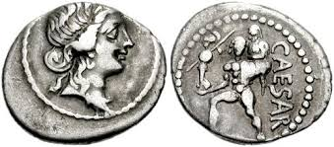
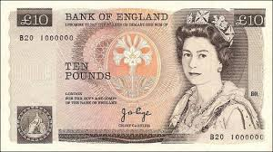
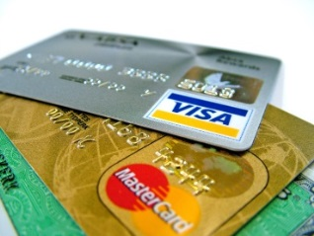
Discussion questions Textbook, p. 30
1. Compare and contrast different forms of money given below. Which features have continued through time? What has changed entirely?
2. What goods may have served as money in the past? Do you know what that money is called?
3. What disadvantages did such money suffer from?
4. What kind of metal were coins with intrinsic value made of? Are these coins still in existence today?
COMMODITY MONEY

