Slide 1
UNIT 1 INVESTIGATING THE ANCIENT PAST

Slide 2
INVESTIGATING THE ANCIENT PAST
How would you define the subject matter of history/archeology?
What are the similarities/differences between studying history and archeology as scientific fields?
Why did you choose to study history/archeology at the university level?
History is the version of past events that people have decided to agree upon.
Napoleon Bonaparte
History is written by the victors.
Walter Benjamin
Archeology is not what you find, it’s what you find out.
David Hurst Thomas
Those that fail to learn from history, are doomed to repeat it.
Winston Churchill
The more you know about the past, the better prepared you are for the future.
Theodore Roosevelt
The archeologist is the best husband a woman can have. The older she gets, the more interested he is in her.
Agatha Christie
Archeology holds all the keys to understanding who we are and where we come from.
Sarah Parcak

Slide 3
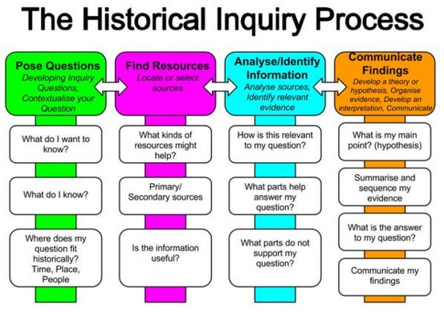
HISTORY AND THE PAST
The common way of defining history is saying that history is the study of the past.
But studying the past is not a simple collection of facts – historians usually look for patterns – e.g. cause and effect, what has remained the same, what has changed and why.
Historians follow a process of historical inquiry:
- a process of investigation that includes posing questions,
locating and analyzing sources and using evidence from
sources to develop an informed explanation about the past.
In reconstructing the past, the aim of a historian is to
identify the best version – or the perspective most likely
to be correct.
Oral accounts, written documents, artifacts and
archeological finds form the basis of research
and investigation in history.
inquiry /ɪnˈkwʌɪ(ə)ri/ - investigation

Slide 4
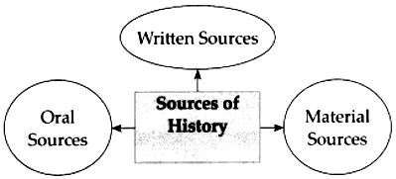
GATHERING THE EVIDENCE
Historians should not rely on only one source of evidence for an inquiry. Why?
Because:
- it may be incorrect or distorted
- it may contain errors – accidental or deliberate
- it may be an exaggeration or it may omit important parts
- it may reflect a strong bias
Historians need to look for and analyze
as many sources of evidence as possible.
distorted – misrepresented, misleading, false
deliberate – intentional
bias /ˈbʌɪəs/ – prejudice for or against someone/something (srp. predrasuda,predubeđenje)
exaggeration /ɪɡˌzadʒəˈreɪʃn/ – a statement that represents something as way better of worse than it really is
to omit – to leave out; to exclude something (spr. izostaviti) omission (n.)

Slide 5
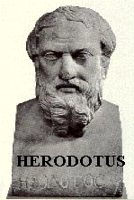
UNDERSTANDING THE PAST
When conducting their investigations (or inquiries), historians rely on the work of many other experts: biologists, geneticists, paleontologists, anthropologists and archeologists, translators, etc.
Just like detectives or journalists, historians ask the 5 basic ‘W’ questions: Who, What, When, Where and Why.
_______________ is often called ‘the father of history’.
Why?
He was the first to record what he had read, saw or heard in a planned and ordered manner.
He is best known for his nine-volume text The Histories which documents the circumstances that had led to the wars between ancient Greece and Persia (480 to 479 BCE).
Herodotus

Slide 6
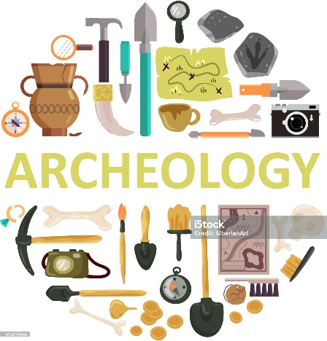
THE ROLE OF ARCHEOLOGISTS
Archeology is the study of past cultures through material (physical) remains.
The remains may include:
- skeletal remains
- the ruins of temples, towns and tombs
- various artifacts
- weapons, tools, coins, inscriptions
- even rubbish dumps (middens)
Archeologists use these remains to understand and re-create all aspects of past cultures.
The archeological record collects, studies, and analyzes all things related to past human activity.
midden – an old dump for domestic waste (srp. otpadne humke)
archeological record – (srp. arheološki zapis) – odnosi se i na fizičke ostatke materijalne kulture pronađene na iskopavanju, ali i na rad arheologa koji stvara arheološku evidenciju

Slide 7
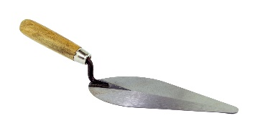
THE ‘DIG’
Since the material remains of past cultures are buried, they have to be excavated (uncovered).
An excavation site is usually called ‘the dig’.
Archeologists first rope off the site, then mark it off into segments, forming a grid.
By using various tools (trowels, brushes, etc.) the archeologists expose the remains, photograph and number them.
They also record details of the size, appearance, the exact location, etc.
to excavate /ˈɛkskəveɪt/ - to remove earth that is covering the objects buried in the ground
excavation (n.)
grid - a pattern or structure made
from horizontal and vertical lines
crossing each other to form squares
trowel /ˈtraʊəl/– a small, handheld tool with a flat, pointed blade
to record /rɪˈkɔːd/ - to document something
record (n.) /ˈrɛkɔːd/ - an account, a document, etc.
e.g. an archeological record

