Slide 1
Unit 3 Scientific techniques for investigating the past

Slide 2
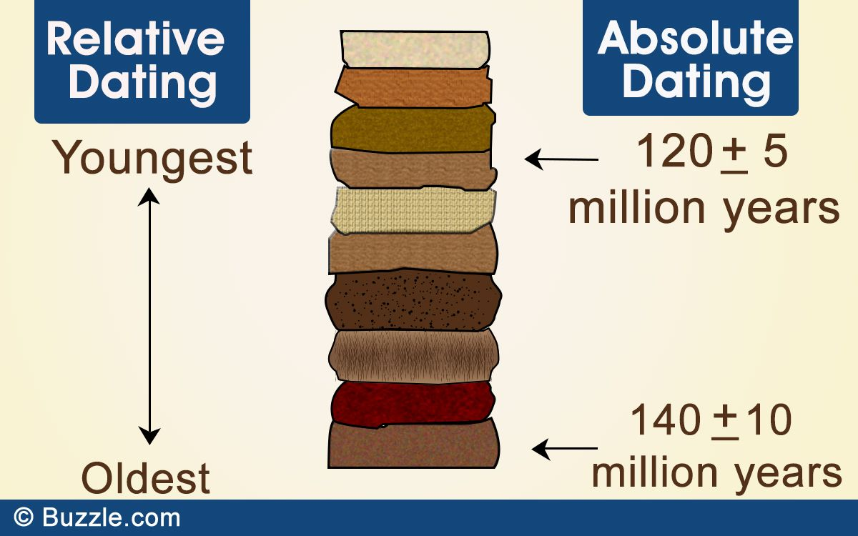
Dating methods
How do archaeologists determine how old an object is?
Can you name any scientific dating methods?
What is the difference between relative and absolute dating methods?
Relative dating methods estimate whether an object is younger or older than other things found at the site. Relative dating does not offer specific dates, it simply allows to determine if one artifact, fossil, or stratigraphic layer is older than another.
Absolute dating methods provide more specific origin dates and time ranges, such as an age range in years. How specific these dates can be will depend on what method is used.
relative and absolute dating techniques are often combined

Slide 3
Scientific dating methods
Some of the most common dating methods are:
STRATIGRAPHY
FLUORINE DATING
RADIOCARBON DATING
DENDOCHRONOLOGY
DNA ANALYSIS
PALYNOLOLGY
ICE-CORE SAMPLING

Slide 4
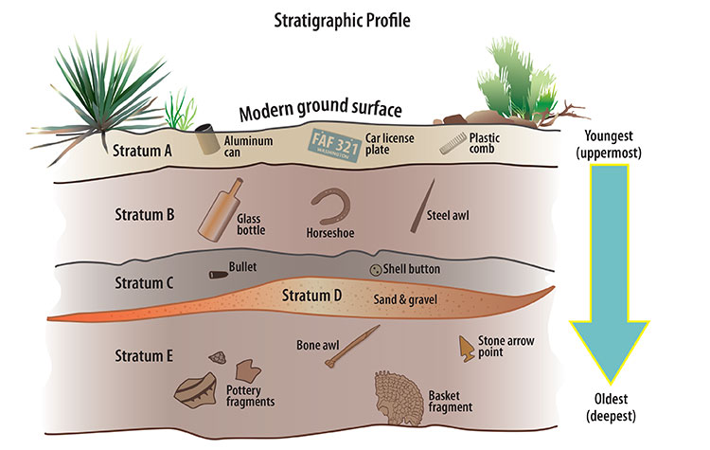
Stratigraphy
stratigraphy (eng.) – stratigrafija (spr.)
Stratigraphy derives from the geological use of the idea that sedimentation takes place according to the law of superimposition.
Over time, sediment, soil, and debris accumulate and layer on top of each other.
In archeology, different artifacts are found within different strata and the law of superimposition can also be applied.
The layers of soil are referred to as “strata” where the uppermost stratum is the youngest and the deepest stratum is the oldest.
The artifacts found in each stratum can thus be dated.

Slide 5
Fluorine dating
fluorine dating (eng.) – fluor test (metod fluora) (spr.)
Fluorine dating (or fluorine absorption dating) analyzes the amount of fluorine that has accumulated in bone over time.
In general, a bone buried earlier in time will contain more fluorine from groundwater/soil than a more recently buried bone.
However, this principle must be tested at each site as fluorine absorption is affected by many environmental factors.

Slide 6
Radiocarbon dating
radiocarbon dating (eng.) – metod radioaktivnog ugljenika (spr.)
Radiocarbon dating, or carbon-14 dating, is a scientific method that can accurately determine the age of organic materials.
First developed in the late 1940s at the University of Chicago by Willard Libby, the technique is based on the decay of the carbon-14 isotope.
Archeologists have long used radiocarbon dating to estimate the age of certain objects.
Traditional radiocarbon dating is applied to organic remains between 500 and 50,000 years old.

Slide 7
Dendrochronology
dendochronology (eng.) – dendohronologija (spr.)
Dendrochronology (or tree-ring dating) is the scientific method of dating tree rings (also called growth rings) to the exact year they were formed in a tree.
In archeology, dendrochronology is used for the purpose of dating wooden structures and artifacts made of wood.
During excavations, the cross-sections of wooden structures and artifacts are compared to regional chronologies to find matching ring patterns and determine a site’s age.
Differing ages in specimens can reveal stages of construction at a particular site, or reveal migration and trade patterns with pieces of wood that were not cut locally.

Slide 8
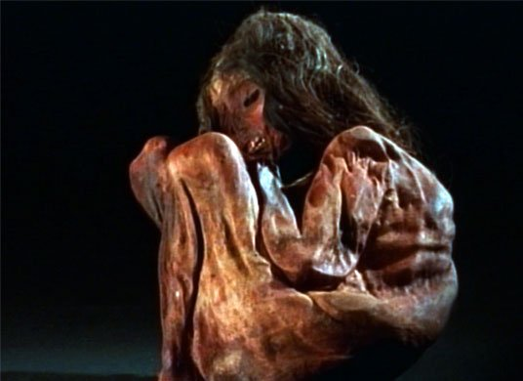
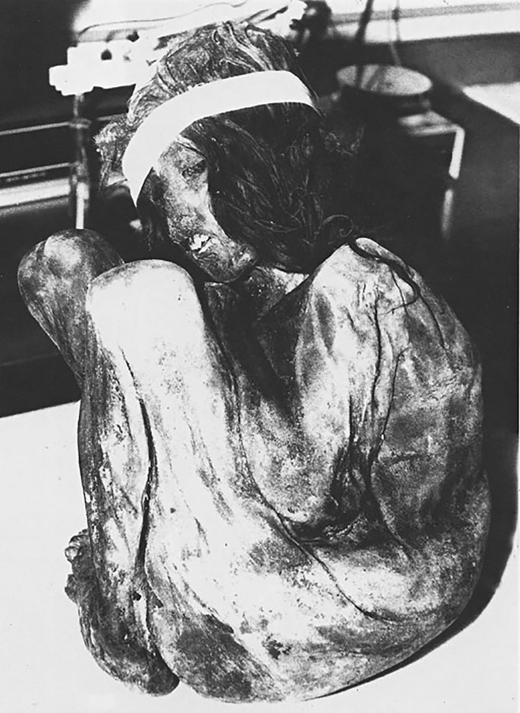
DNA analysis
DNA analysis (eng.) – DNK analiza (spr.)
Ancient DNA (aDNA) is a powerful tool for studying the past – when archeologists and geneticists work together.
For example, the Inca child mummy:
discovered in 1985 by mountaineers on Aconcagua mountain in Argentina
his body was wrapped in cloth and surrounded by six small statues
the mummy is part of the sacrificial rite
child sacrifice was performed during the reign of the Incas in South America
children were taken to high mountain peaks and killed or left to die
At first, aDNA testing was limited to skeletons from cold climates where DNA molecules are more likely to be preserved. Success rates have steadily improved with cheaper and more efficient laboratory techniques and now aDNA is applied to archeological skeletons in museums as well.

Slide 9
Palynology
palynology (eng.) – polinologija (nauka o polenu) (spr.)
Palynology, or the study of pollen grains, is used to reconstruct ancient environments and document environmental changes that had significant impacts on past human societies.
In archeological studies, pollen analysis is corroborated with other historical information and excavated materials. It helps to reconstruct past vegetation and different types of human activities associated with land use (agriculture, grazing, woodland exploitations etc.) The impact of such activities can be inferred along with past climatic situations.

Slide 10
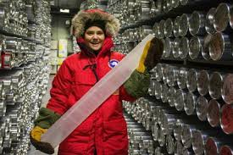
Ice-core sampling
ice-core sampling (eng.) – uzorkovanje ledenih jezgara (spr.)
An ice core is a sample that is typically removed from an ice sheet or a high mountain glacier. Since the ice forms from the buildup of annual layers of snow, lower layers are older than upper ones, and an ice core contains ice formed over a range of years.
The physical properties of the ice and of material trapped in it can be used to reconstruct the climate over the age range of the core.
lead /lɛd/ - (srp.) olovo
It is well-known among historians that the Roman Empire (27 BCE to 1453 CE) used lead in much of their infrastructure, including water pipes and construction materials. Additionally, the Romans smelted silver, a process that releases lead particles into the atmosphere, to mint currency. However, it remained unappreciated just how much lead the Roman Empire released into the atmosphere. In fact, most researchers previously assumed that atmospheric lead levels only began to increase at the onset of the Industrial Revolution, and that prior human lead pollution was minimal. By studying ice cores, researchers found that lead levels have been elevated since the time European civilizations began using lead, long before the Industrial Revolution.
Historians and scientists claim that during the Roman Empire, heavy lead pollution corresponded with times of prosperity, such as the Pax Romana (27 BCE to 180 CE), a two hundred year period of relative peace, trade, and imperial stability. Conversely, lead emissions decreased in times of war.

Slide 11
Scientific dating methods
Which of these dating methods are absolute and which are relative:
STRATIGRAPHY
FLUORINE DATING
RADIOCARBON DATING
ICE-CORE SAMPLING
DENDOCHRONOLOGY
PALYNOLOGY
ABSOLUTE DATING METHODS
RELATIVE DATING METHODS

