Slide 1
Unit 3 Scientific techniques for investigating the past

Slide 2
Vocabulary practice Textbook, p. 32
A. Match the words from the text with their synonyms or explanations:
1. trunk | a. evaluate or estimate the nature or quality of something
2. to absorb | b. speed
3. immersed | c. to take in a substance
4. soil | d. a collapse of a mass of earth or rock from a mountain or cliff
5. stratum | e. precise
6. landslip | f. earth, ground
7. to work out | g. a layer
8. accurate | h. to calculate
9. sample | i. to undergo chemical decomposition
10. to assess | j. the main woody stem of a tree different from its branches and roots
11. rate | k. specimen
12. to break down | l. submerged
J
C
L
F
G
D
H
E
K
A
B
I

Slide 3
Word formation Textbook, p. 33
B. Supply the missing word forms and insert them in the sentences below:
VERB | NOUN | ADJECTIVE
COMPARE
 | MEANING
BASE
 | USE
 | ORIGIN
COMPARISON
COMPARABLE/COMPARATIVE
MEAN
MEANINGFUL/-LESS
BASIS
BASIC
USE
USEFUL/-LESS; USABLE
ORIGINATE
ORIGINAL
1. In_________________with all other scientific methods, this seems to be the most appropriate one for dating this source of evidence.
2. The archeologists haven’t discovered anything_______________recently.
3. We still need to do a_________________analysis of these two historical remains.
4. These sources of evidence are very_______________for our historical inquiry.
5. If the artifact cannot be studied it is essentially________________.
6. These results are not very_________________. We have to do the analysis once again and use different data.
7. We haven’t been able to trace the_______________of that particular source.
8. Only_______________documents represent the key point of historical interest.
9. Artifacts and archeological finds form the________________of research and investigation in history.
10. These two items are not_______________because they________________from different time periods.
comparison
meaningful
comparative
useful
useless
usable
origin
original
basis
comparable
originate

Slide 4
Terms and definitions Textbook, p. 33
TERM | DEFINITION
1. archeological record | a. the unmodified remains of biological materials
2. artifacts | b. non-portable objects used or constructed by people
3. ecofacts | c. specific localities where people lived, worked, or visited
4. features | d. the surviving physical remains of past human activities, which are recovered, analyzed, preserved and described by archeologists in an attempt to reconstruct the past
5. archeological sites | e. portable objects which contain a wide range of information about the people who lived in the past
D
E
A
B
C
1. The______________includes the physical (not written) evidence about the past (e.g. the remains of tools, houses, foods, or any other materials abandoned by the people in the past).
2._______________consist of tools or other objects manufactured or used by people to accomplish a specific task.
3. Most_____________consist of food residues, such as the bones of animals or the seeds or other parts of plants.
4. Examples of______________include hearths, houses, walls, and other similar objects.
5. An______________is a place (or group of physical sites) in which evidence of past activity is preserved.
arch. record
Artifacts
ecofacts
features
arch. site

Slide 5
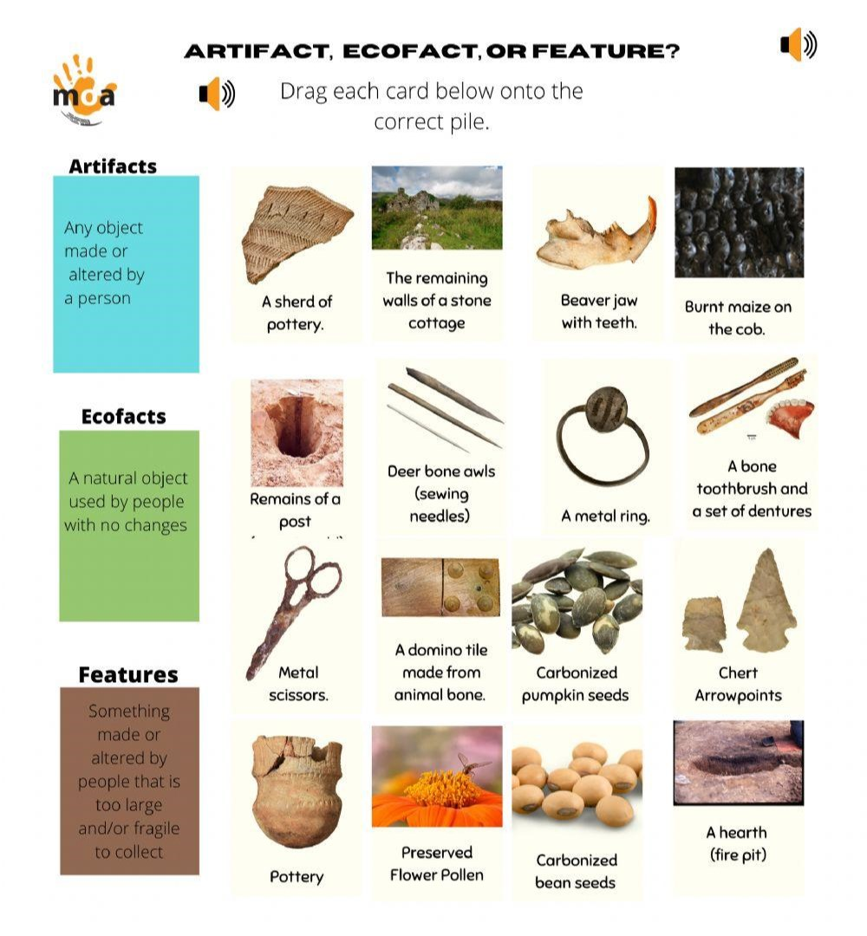
Artifacts, ecofacts and features
ARTIFACTS
a shred of pottery
deer bone awls (sewing needles)
a metal ring
a bone toothbrush and a set of dentures
metal scissors
a domino tile made from animal bone
arrow points
pottery
ECOFACTS
beaver jaw with teeth
burnt maize (corn) on the cob
carbonized pumpkin seeds
preserved flower pollen
carbonized bean seeds
FEATURES
the remaining walls of a stone cottage
remains of a post
a hearth (fire pit)

Slide 6
Past Simple, Present Simple, Present Perfect Textbook, p. 34
D. Insert the verbs in brackets into Past Simple, Present Simple or Present Perfect Simple Tense:
have developed
is
found
used
has participated
is
has travelled
have examined

Slide 7
Past Simple, Present Simple, Present Perfect Textbook, p. 34
Decide which of the sentences from the previous slide concerns the following:
USE | SENTENCE NUMBER
1. to refer to a past event which happened at a specific time in the past | Sentences
2. to refer to facts | Sentences
3. to refer to activities which happened at some non-specific time in the past | Sentences
4. to refer to activities within a period of time which is not yet finished at the time of speaking | Sentences
3
4
2
6
1
8
5
7

Slide 8
Present Simple, Past Simple or Present Perfect? Textbook, p. 34
Suppressing the voices of difference
Throughout history, attempts (1)_____________(MAKE) by the powerful to suppress views that (2)_____________(CONFLICT) with the ‘official’ view. Often this (3)____________(DO) by destroying sources that (4)______________(PRESENT) differing views.
For example, the Egyptian pharaoh Akhenaten (5)_____________(DECIDE) in 1344 BCE that Egypt (6)_____________(WORSHIP) only one god, Aten, the Sun god. He (7)____________(DESTROY) as many records as he could that declared there (8)____________(BE) many gods.
Suppression of unwelcome voices (9)____________(NOT/CONFINE) to the far past. In the 1930s, Nazis in Germany (10)____________(ORDER) some 20,000 books burned since these works (11)____________(NOT/AGREE) with the regime’s racist views. The unfortunate thing for historians (12)____________(BE) that much of these destroyed sources (13)____________(BE/CONSIDER/NOW) as valuable evidence of the past. This is why it (14)____________(BE) important for all historians, and students of history, to keep an open mind when examining sources. This (15)___________(MEAN) knowing our own prejudices for these may influence how we (16)____________(VIEW) or (17)____________(INTERPRET) a source. It also means recognizing any gaps and silences in a source. These (18)__________(BE) often deliberate, reflecting the creator’s biases.
have been made
conflict
is done
present
decided
worshipped
destroyed
were
is not confined
ordered
didn’t agree
is
are now considered
is
means
view
interpret
are

Slide 9
Gap-filling exercise Textbook, p. 35
F. Fill in the blanks using the appropriate word given in the box:
exhibit – collection of objects on public display (srp. postavka)
Museums - main characteristics
A museum is an institution that (1)____________a collection of artifacts and other objects of scientific, artistic, cultural, or historical importance and makes them (2)____________for public viewing through (3)_____________that may be permanent or temporary. Most large museums are located in major cities throughout the world and more local ones exist in smaller cities and towns. Museums have (4)_____________aims, ranging from serving researchers and specialists to serving the general (5)____________. Early museums began as the (6)___________collections of wealthy individuals, families or institutions of art and rare or (7)___________natural objects and artifacts. The first public museums were often (8)_____________only to the middle and upper classes. Gaining (9)_____________to such museums was difficult - in London for example, prospective visitors to the British Museum had to apply in (10)____________for admission and had to wait two weeks for an (11)____________ticket.
conserves
WRITING
CONSERVES
EXHIBITS
ENTRANCE
VARYING
PRIVATE
ACCESSIBLE
AVAILABLE
CURIOUS
PUBLIC
ADMISSION
available
exhibits
varying
public
private
curious
accessible
entrance
writing
admission
curious – strange
admission ticket – entrance ticket

Slide 10
Correlative conjunctions Textbook, p. 35
G. Match the following correlative conjunctions and insert them in the sentences below:
neither | but also
both | or
not only | or
whether | nor
either | and
1. The archeologist could ____________ confirm ___________ deny the speculation that the source of the inscription had finally been revealed.
2. They believe that this method is ____________ simple ___________ effective.
3. You can _____________ come by bus _____________ take a taxi to the museum.
4. The archeologists will ____________ open the tomb _________ also compare the DNA results with the ones obtained last year.
5. The scientists don’t know ___________ the remains belong to the same period ___________ not.
neither
nor
both
and
either
or
not only
but
whether
or

Slide 11
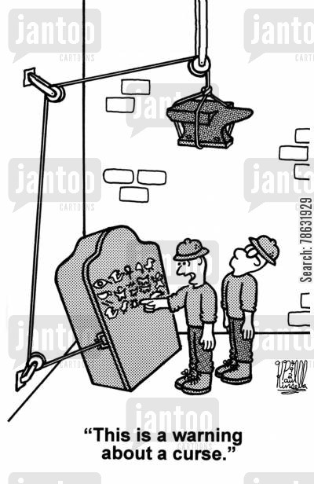
Word formation Textbook, p. 35-36
The Louvre museum
The Louvre palace was begun by King Francis I in 1546. Francis was a great art (1)_____________(COLLECT), and the Louvre was to serve as his royal (2)_____________(RESIDE). The work, which was supervised by the architect Pierre Lescot, continued after Francis’ death and into the (3)____________(REIGN) of kings Henry II and Charles IX. Almost every subsequent French monarch (4)___________(EXTENSION) the Louvre and its grounds, and major (5)__________(ADD) were made by Louis XIII and Louis XIV. In 1682, the Louvre (6)____________(CESSATION) to be the main royal residence.
The (7)____________(COLLECT) at the Louvre grew (8)____________(RAPID), and the French army stole art and (9)____________(ARCHEOLOGY) items from the territories and nations conquered in (10)___________(NAPOLEON) wars. Much of this (11)___________(SEIZURE) art was returned after Napoleon’s defeat in 1815.
Two new wings were added in the 19th century, and the Louvre complex was completed in 1857. In 1993, a wing (12)___________(FORMER) occupied by the French Ministry of Finance, was opened to the public. It was the first time that the (13)__________(ENTIRELY) Louvre was devoted to museum purposes. Today, the Louvre’s collection is one of the (14)__________(RICH) in the world, with artwork and artifacts (15)__________(REPRESENT) of 11,000 years of human civilization and culture.
collector
residence
reigns
extended
additions
ceased
collection
rapidly
archeological
Napoleonic
seized
formerly
entire
richest
representative

Slide 12
Gap-filling exercise Textbook, p. 36
History museums - role and mission
The primary (1)___________of most history museums is to collect, preserve, exhibit and interpret objects of historical significance. Over time, all objects will begin to (2)__________for a (3)___________of reasons, such as environmental conditions, use and natural (4)__________.
In order to (5)__________the objects in such condition so that they will survive for the education of future generations, it is vital that museums practice proper (6)___________measures.
Knowing how to handle, display and store the (7)__________in your museum’s (8)___________can add a significant number of years to the life of the objects. Most history museum collections consist of two basic categories of materials - organic and inorganic.
(9)___________artifacts include those made from animal products such as fur, leather, wool, silk, bone or feathers and also those made from plant products such as wood, paper, cotton and other natural (10)___________. (11)___________artifacts are those made from non-living materials such as metal, stone, ceramics and glass. Even though inorganic materials are more (12)__________and less (13)___________to environmental damage than organic materials, it is best to consider all objects (14)__________and to treat them with great care.
mission
deteriorate
DECAY
FIBERS
ORGANIC
MISSION
DETERIORATE
ARTIFACTS
COLLECTION
PRESERVATION
INORGANIC
FRAGILE
STABLE
VARIETY
MAINTAIN
SUSCEPTIBLE
variety
decay
maintain
preservation
artifacts
collection
Organic
fibers
Inorganic
stable
susceptible
fragile

Slide 13
Prepositions Textbook, p. 37
AT FOR IN TO ON OF
1. Historical sources are items that a historian looks______, and looks______, to investigate the past.
2. These two artifacts are similar______size.
3. I am looking forward______joining the team of these expert archeologists next year.
4. The size and scope of archeological excavation depends______the resources and funds available.
5. There are thousands of historians_____work today, but they work_____a wide variety of jobs.
6. The original date of the translation is irrelevant______its value as a historical source.
7. Historians sometimes limit themselves______source material that is digitally available.
8. He was the only heir______the Earl of Lancaster.
9. He had not left a male heir______the throne as the children that he had were stillborn.
10. Delays______the process of excavation can be attributed______bad weather and poor working conditions.
11. If we excavate here, we have to consider the potential threats______the excavation site.
12. I wish I had a solution______this problem.
13. His signature______the end of the document proves its authenticity.
14. Merchants in many early societies commonly traveled______foot, carrying trade goods on the backs of animals.
15. Animal skins were______great demand at that time.
16. Contrary_____popular belief, archeologists do not study dinosaurs or fossils - that is the job of paleontologists.
for
at
in
to
on
at
in
to
to
of
to
in
to
to
to
at
on
in
to

