Slide 1
Unit 4 Key features of ancient societies

Slide 2
Key features of ancient societies
1. In the earliest societies, people were typically either hunters or gatherers. What influenced the shift from their nomadic lifestyle to a more sedentary one? How did the first fixed (permanent) settlements develop?
2. What geographical features influenced the creation of early fixed settlements?
3. What are, in your opinion, some of the key features common to all ancient societies?

Slide 3
The Neolithic revolution
The shift in human behavior - from hunting and gathering to farming - took place in many societies at different times.
It was such a significant development that it is often called a revolution: the Neolithic Revolution.
Some of the first fixed settlements developed in fertile river valleys since the environment of these valleys allowed the people to produce significant quantities of food.
As agricultural societies flourished, no longer did everyone have to be involved in producing food. There was time for those who were not farmers to learn new skills.

Slide 4
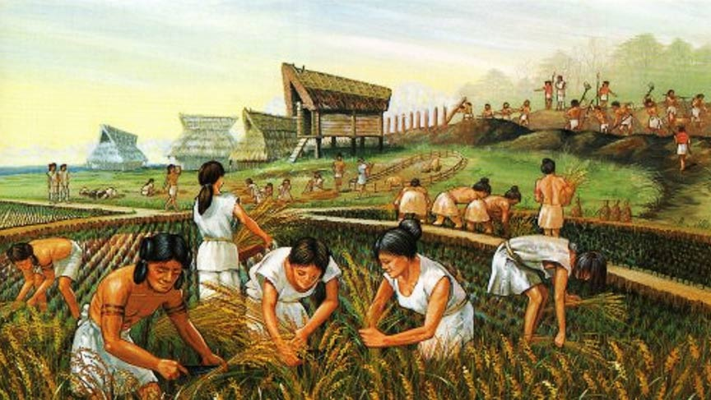
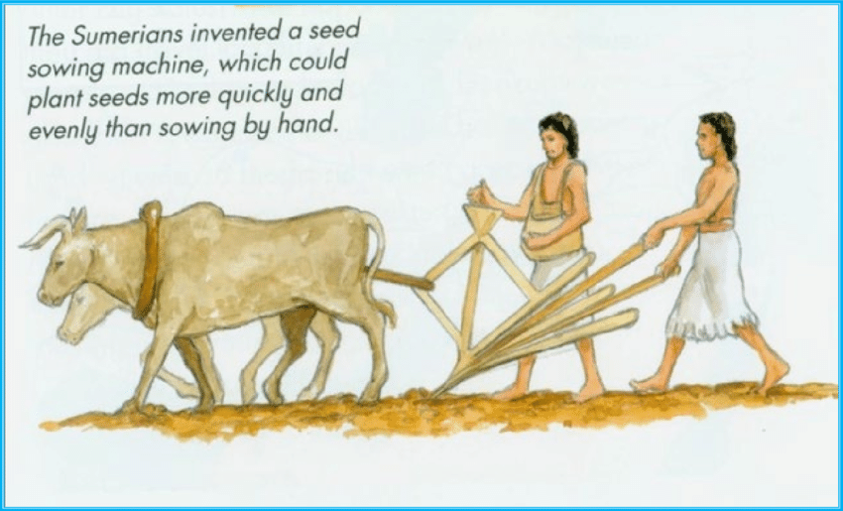
The growth of farming
The world’s first farmers lived in Mesopotamia.
Wheat and barley were among the first crops grown, and sheep and goats were among the first animals to be domesticated.
Ancient Sumer developed around 5000 BCE to the south of Mesopotamia, between the Tigris and Euphrates rivers in today’s Iraq. (Mesopotamia is a Greek word that means ‘between rivers’.) THE FERTILE CRESCENT
The people first learned to grow crops and then how to divert river water along irrigation channels.
By about 4000 BCE, they had developed an ox-drawn plough.
wheat /wiːt/ - pšenica (srp.)
barley /ˈbɑːli/ - ječam (srp.)
irrigation - the supply of water to land or crops to help growth

Slide 5
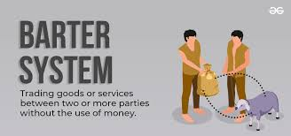
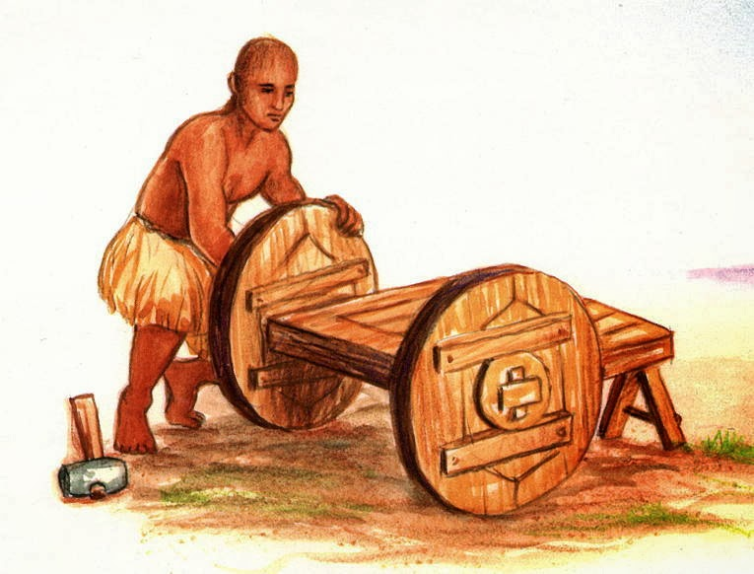
Trade and ancient economies
With the development of agriculture, people had some control over their food supply. Excess food was stored for times when harvests might be poor, or for trading with other communities.
Fixed settlements (later villages and towns) began to exchange their goods for other goods they needed.
Until the use of currency, people exchanged goods for other goods of approximately equal value. This practice is called bartering.
barter – trampa (srp.)
Merchants in many early societies traveled on foot, carrying trade goods on the backs of animals.
The invention of the wheel in ancient Mesopotamia allowed transport in carts.

Slide 6
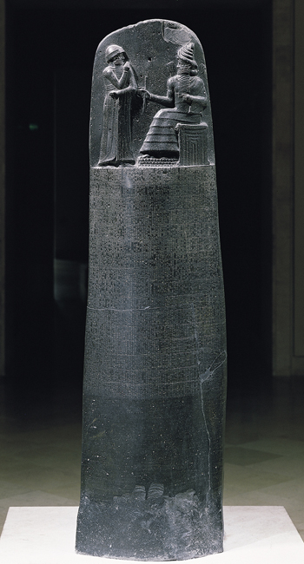
Development of law
The first laws were people’s day-to-day customs. As societies became more complex, ‘rules’ about how people should behave became more structured.
Some of the earliest written laws are attributed to Hammurabi, king of Babylon. He recorded a detailed set of 282 laws: the Code of Hammurabi.
The top of the stele features an image of Hammurabi with Shamash, the Babylonian sun god and god of justice. Below are about 4,130 lines of cuneiform text.
stele /stiːl/ - stela sa reljefom (srp.)
cuneiform /ˈkjuːnɪfɔːm/ - klinasto pismo (srp.)

Slide 7
Development of social classes
At the top – rulers
nearly always men
kings (ruled the Etruscans (founders of ancient Rome)
emperors (ancient China and Rome)
pharaohs (ancient Egypt)
In the middle
religious groups such as priests
administrative groups such as tax collectors, scribes and advisors
merchants and artisans (potters, weavers, sculptors, goldsmiths, etc.)
And at the bottom ... slaves
the lowest social class in ancient societies
most were prisoners of war or people in debt
did farm work or other manual jobs or were part of households, providing domestic and sometimes tutoring services
had few legal or personal rights

