Slide 1
Unit 2 Key concepts for historical inquiry

Slide 2
Vocabulary practice Textbook, p. 22
A. Match the words from the text with their synonyms or explanations:
1. plumbing | a. an object made by a human being, typically one of cultural or historical interest
2. legacy | b. effect or influence
3. to assign | c. outcome
4. to investigate | d. to allocate, to give
5. consequence | e. the system of pipes and tanks required for the water supply
6. account | f. building material made from a mixture of broken stone, sand, cement, and water
7. artifact | g. something left or handed down by a predecessor
8. concrete | h. a report or description of an event or experience
9. impact | i. to carry out a systematic or formal inquiry to discover and examine the facts
10. event | j. a thing that happens or takes place
E
G
D
I
C
H
A
F
B
J

Slide 3
Word formation Textbook, p. 22-23
B. Supply the missing word forms and insert the appropriate ones in the sentences below:
VERB | NOUN | ADJECTIVE
INFLUENCE
ACCESS
EXPLAIN
 | DEVELOPMENT
AFFECT
 | ANALYSIS
INFLUENCE
INFLUENTIAL
ACCESS
(IN)ACCESSIBLE
EXPLANATION
EXPLICABLE/EXPLAINABLE
DEVELOP
DEVELOPMENTAL
EFFECT
(IN)EFFECTIVE
ANALYZE
ANALYZABLE/ANALYTICAL
1. Unfortunately, most of the relevant sources of evidence were____________at that point in time.
2. When considered in the light of this new information, the origin of that old document seems more____________.
3. His study focuses on several different____________stages of the Greek city-states.
4. The concept of cause and_____________is one of the most important concepts in historical inquiry.
5. In assessing the age of that particular source, this method has unfortunately proved to be_____________.
6. Just like anyone else, historians have perspectives which can____________their interpretation of the past.
7. Historians sometimes limit themselves to source material that is digitally available and easily searchable and____________.
8. Digitally available sources are the ones which can____________by different historians around the world at the same time.
inaccessible
explicable
developmental
efffect
ineffective
affect
analyzable
be accessed

Slide 4
Terms and definitions Textbook, p. 23
C. Match the key historical concepts with their appropriate definition:
TERM | DEFINITION
1. source | a. information gained from an investigation of items that supports a particular conclusion
2. empathy | b. able to be argued as different interpretations are possible
3. significance | c. qualities observed in developments where some aspects reflect the past, while others reflect more recent influence
4. evidence | d. the ability to view events/people through the ‘lens’ of their times/cultures
5. continuity and change | e. an item that existed or was made in the past, or that is made about the past
6. contestability | f. of note because of its far-reaching or long-term impact, or the effect or influence it created
7. cause and effect | g. different points of view about a particular event, person, civilization, etc.
8. perspective | h. pertains to the reasons why events occurred and the resulting consequences
E
D
F
A
C
B
H
G

Slide 5
Expressions containing the word ACCOUNT Textbook, p. 24
E. Match the phrases on the left which contain the word ACCOUNT with their definitions on the right and use them in the sentences below:
1. to take something into account | a.used to say in a strong and definite way that something must not happen or be done
2. on no account/not on any account | b. according to what people say
3. on account of | c. not or not very important
4. by all accounts | d.to consider something when you are trying to make a decision
5. of no account/of little account | e. give a written or spoken report about something that has happened
6. to give an account of something | f. to be the reason why something exists or happens
7. to account for something | g. because of someone or something
D
A
G
B
C
E
F

Slide 6
Expressions containing the word ACCOUNT Textbook, p. 24
1. to take something into account
2. on no account/not on any account
3. on account of
4. by all accounts
5. of no account/of little account
6. to give an account of something
7. to account for something
1. A number of factors_________________the differences between the two artifacts.
2. Herodotus relied on numerous eyewitnesses______________________what had happened in the past.
3. Sparta was,___________________, a very powerful city-state.
4. It is_________________their numerous conquests that they secured the expansion of the country borders.
5. A historian should not,_______________________, break the confidence of his sources.
6. Herodotus_________________________various stories obtained from unreliable sources when he was writing The Histories.
7. This particular evidence is unfortunately of_________________________for the historical inquiry.
account for
to give an account of
by all accounts
on account of
on any account
took into account
no/little account

Slide 7
Prepositions Textbook, p. 24
F. Match the verbs with the prepositions and then insert the appropriate combinations in the sentences below:
1. RESULT | a. WITH
2. CRITICIZE | b. TO
3. CONFLICT | c. FROM
4. CONTRIBUTE | d. IN
5. COMPARE | e. FOR
6. RESULT | f. ON/UPON
7. RELY | g. WITH/TO
IN
FOR
WITH
TO
WITH
TO
FROM
ON
1. Last year the archeologists____________huge amounts of their time__________the project.
2. These results______________the ones we have obtained earlier this year.
3. It is difficult to__________the results of this study________the ones of the other because the authors have clearly used different methods for the analysis of data.
4. Problems that have arisen______________his inaccurate analysis of the data.
5. The archeologists at the site believe that all this hard work will_______________new discoveries.
6. Herodotus was often______________using unverified information as well as for _______________his own observations only.
contributed
TO
conflict WITH
compare
TO/with
result FROM
result IN
criticized FOR
relying ON

Slide 8
Gap-filling exercise Textbook, p. 25-26
H. Match the appropriate word with its meaning:
✓ CONCLUDE | ✓ JUSTIFY | ✓INTERPRET | ✓ COMPARE
PREDICT | ✓EVALUATE | ✓ANALYZE | ✓CONTRAST
WORD | MEANING
1. | explain how two or more things are similar
2. | explain how two or more things are different
3. | defend your opinion, with examples
4. | assess the worth of something
5. | critically examine different aspects of a topic
6. | explain what you think is the meaning, impact, significance, outcome and so on
7. | make an informed guess about an outcome
8. | decide after careful thought
COMPARE
CONTRAST
JUSTIFY
EVALUATE
ANALYZE
INTERPRET
PREDICT
CONCLUDE

Slide 9
Gap-filling exercise Textbook, p. 25-26
Insert the verbs from the table above into the following sentences. Use the appropriate tense/form of the relevant verbs.
✓ CONCLUDE | ✓ JUSTIFY | ✓INTERPRET | ✓ COMPARE
PREDICT | ✓EVALUATE | ✓ANALYZE | ✓CONTRAST
1. Archeology is closely related to cultural anthropology because archeologists strive to learn about individual past cultures and then_____________and___________what is learned about various past groups to form a broad understanding of human behavior.
2. Archeologists rely on various specialists to help them____________what is found.
3. Differences in opinion usually arise when we____________data. Two researchers can look at the same information and come to different conclusions.
4. If we want to determine the value or worth of something we need to have a set of pre-decided criteria. What criteria did they use to_____________the worth of this 18th century vase?
5. In their research, archeologists and historians have to rely on numerous sources of evidence to ___________their conclusions.
6. The most important question is what we can____________from all the data that we have analyzed so far.
7. My colleagues think that it is too early to____________the results of this research.
CONTRAST
COMPARE
INTERPRET
ANALYZE
EVALUATE
JUSTIFY
CONCLUDE
PREDICT

Slide 10
Past Simple or Past Continuous Tense? Textbook, p. 26-27
J. Insert the verbs in brackets into Past Simple or Past Continuous Tense:
1. Just as I_____________(FINISH) the last part of my project they_____________(CALL) to tell me that its funding had been cancelled.
2. Rome_____________(BECOME) a Republic in 509 BCE.
3. Several archeologists______________(EXCAVATE) the remains from that particular site all day yesterday.
4. While they_______________(EXCAVATING), other members of the team______________
(RECORD) relevant details.
5. By about 3300 BCE, the Nile settlements_____________(GROUP) into two kingdoms: upper and lower Egypt.
6. In 332 BCE, Alexander the Great, the king of Macedon, _______________(CONQUER) Egypt.
7. Herodotus_______________(WRITE) a systematic study of the past called The Histories.
8. The first ancient Olympic Games_______________(TAKE) place in 776 BCE.
9. I_____________(STUDY) in the library when you______________(CALL) yesterday.
10. A British team______________(LEAD) the investigation into the remains found in Egypt last year.
was finishing
called
became
were excavating
were excavating
were recording
grouped
conquered
wrote
took
was studying
called
led

Slide 11
Past Simple or Past Continuous Tense? Textbook, p. 26-27
Decide which of the above given sentences concerns the following:
USE | SENTENCE NUMBER
1. to refer to a past event which happened at a specific time in the past | Sentences
2. for a past action in progress | Sentence
3. for two parallel past actions in progress | Sentences
4. for an action that was in progress when something else happened | Sentences
5. to refer to events or actions which are not in any way connected with the present (e.g. historical events) | Sentence
2
5
6
8
10
3
4
1
9
7

Slide 12
Past Simple or Past Continuous Tense? Textbook, p. 27
Site excavation
Last week, several archeology students (1)____________(PARTICIPATE) in the excavation of a site approximately 40 miles south-east of Rome. Professor Smith, a faculty member of Temple University Rome (2)____________(BE) in charge of the excavation while Peter Hinner, a renowned archeologist, (3)_____________(PROVIDE) practical assistance to students. The professor first (4)_____________(DIVIDE) students into two groups and then (5)___________(GIVE) each group particular tasks.
While some students (6)___________(REMOVE) vegetation from the site, other students (7)____________(TRY) to establish a grid on the surface. Once they (8)____________(MARK) the site, all students (9)____________(JOIN) forces and (10)____________(START) to remove dirt very slowly because they (11)___________(NOT/KNOW) what they would discover. Then, using shovels, the students (12)___________(BEGIN) to uncover a site square by square.
While the students (13)____________(WORK), the professor (14)____________(MAKE) notes of their progress. Because he (15)_____________(NOT/PAY) close attention to what the students (16)_____________(DO) while he (17)______________(BE) busy with note-taking, one of the students, obviously in a hurry to complete the excavation process, accidentally (18)____________(DAMAGE) an important source of evidence.
participated
was
provided
divided
gave
were removing
were trying
marked
joined
started
didn’t know
began
were working
was making
wasn’t paying
were doing
was
damaged

Slide 13
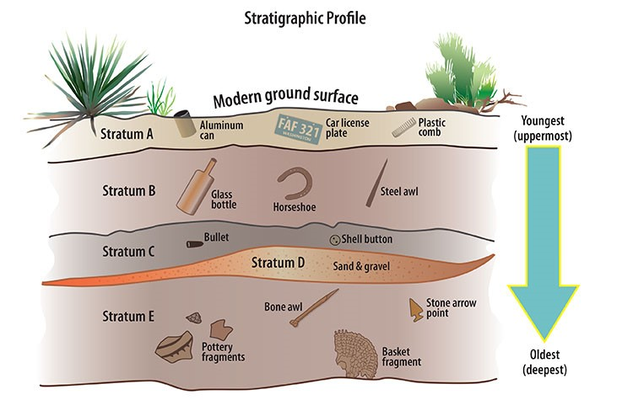
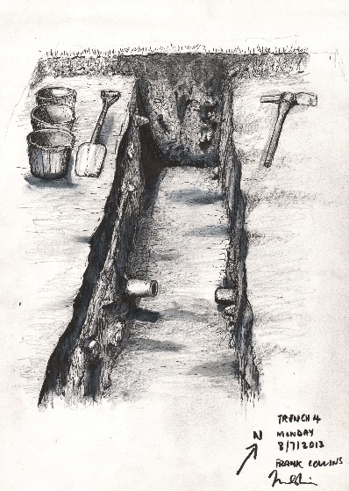
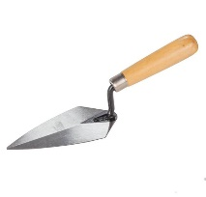
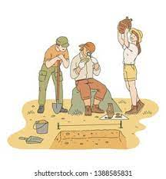
Terms and definitions Textbook, p. 27-28
L. Match the archeological terms with their definitions and use the appropriate ones in the sentences below:
TERM | DEFINITION
1. trowel | a. refers to all the work that is done to collect information about a particular archeological site
2. site | b. layers of earth or levels in an archeological site (singular stratum)
3. strata | c. a network of uniformly spaced squares that divides a site into test units
4. artifact | d. triangular, flat metal hand tool used to remove soil from an excavation unit on an archeological site
5. grid | e. a part broken off, a piece of something
6. fragment | f. the term denotes the area containing evidence of human activity
7. fieldwork | g. the systematic digging and recording of a site
8. excavation | h. the relationship of artifacts to each other and to where they are found
9. context | i. any object made, modified or used by people
10. trench | j. a long, narrow hole that is dug in the ground
D
F
B
I
C
E
A
G
H
J

Slide 14
Terms and definitions Textbook, p. 28
TERM
1. trowel
2. site
3. strata
4. artifact
5. grid
6. fragment
7. fieldwork
8. excavation
9. context
10. trench
1. There are several stages in the archeological process. They include_____________, surveying and analysis.
2. In order to analyze the recovered______________, an archeologist must be able to study the_____________in which these items were found.
3. A______________is a useful tool which helps the archeologist in determining the exact contents of the soil and its environment.
4. Laying a______________is essential for any archeological dig because it marks small units of the______________and allows exact measurements.
5. Any form of archeological research which is done in an actual setting in the natural environment rather than in a laboratory or a museum is called________________.
6.______________are generally deeper than they are wide and they provide an overview of the different_______________of sediment deposits.
7. ‘______________of Humanity’ is the title of the first major exhibition dedicated to Québec archeology.
excavation
artifacts
context
trowel
grid
site
fieldwork
Trenches
strata
Fragments

Slide 15
Past Simple or Past Perfect Tense? Textbook, p.
attempted
had occurred
(had) led
had ever made
had tried
described
had witnessed
didn’t speak
had
was often
had made
were
started
had been
had conquered
developed
emerged
had roamed
had already discovered

Slide 16
Negative prefixes Textbook, p. 28-29
____reliable | ____reversible | ____conceivable
____limited | ____conventional | ____coherent
____biased | ____interpretation | ____stability
____relevant | ____avoidable | ____correct
UN
IR
IN
UN
UN
IN
UN
MIS
IN
IR
UN
IN
1. This particular source of evidence has proved to be______________and therefore of no practical use for the investigation.
2. The timeline of historical events in this book is______________and does not accurately reflect the cause-and-effect relationship.
3. Historians should be able to provide an____________account of past events.
4. The original date of the translation of the document is_____________to its value as a historical source.
5. The concept of cause-and-effect is linked to the______________course of events.
6. This database provides______________access to authentic historical documents.
unreliable
unreliable
incorrect
unbiased
irrelevant
irreversible
unlimited

Slide 17
Negative prefixes Textbook, p. 28-29
____reliable | ____reversible | ____conceivable
____limited | ____conventional | ____coherent
____biased | ____interpretation | ____stability
____relevant | ____avoidable | ____correct
UN
IR
IN
UN
UN
IN
UN
MIS
IN
IR
UN
IN
7. The____________circumstances of those events eventually led to the fall of Rome.
8. His account of the past events lacks orderly continuity, arrangement and relevance. Therefore, it is completely_____________.
9. It is_____________that anyone could have survived such a violent attack.
10. Any analysis of past events is prone to______________.
11. Those were the times of great political and social_____________.
12. We value the lectures of our history professor because he encourages________________thinking, i.e. he encourages us to think in new ad different ways.
unavoidable
incoherent
inconceivable
misinterpretation
instability
unconventional

Slide 18
Gap-filling exercise Textbook, p. 29
simplistic
representations
1. Can you think of any events in history that can be explained in terms of stereotypes or prejudices?
2. Do you think certain groups are more subject to stereotyping than others? If so, why?
3. How can the media (newspapers, television, movies) help to increase/reduce stereotyping?
perception
complex
assumption
Historical
division
largely
historians

